Slide 1
Project of Team Seagro
Taufique khan

Slide 2
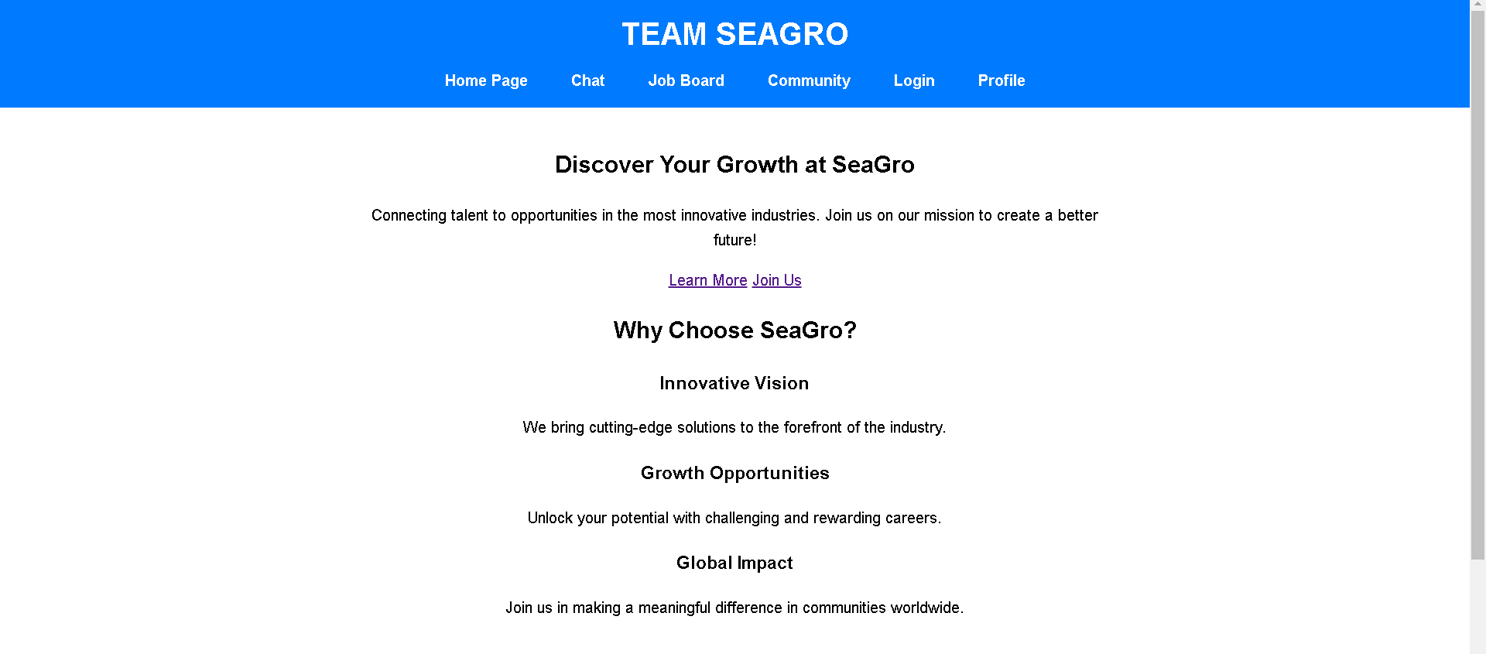
HOMEPAGE
Hero section introducing TEAM SEAGRO and its mission.
Features section highlighting innovation, growth opportunities, and global impact.

Slide 3
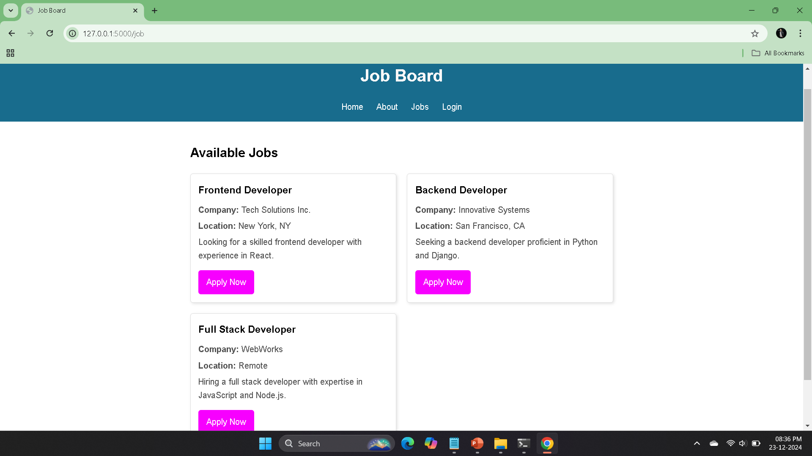
Job Board
. A central hub for dynamic job postings with placeholder for backend
integration.

Slide 4
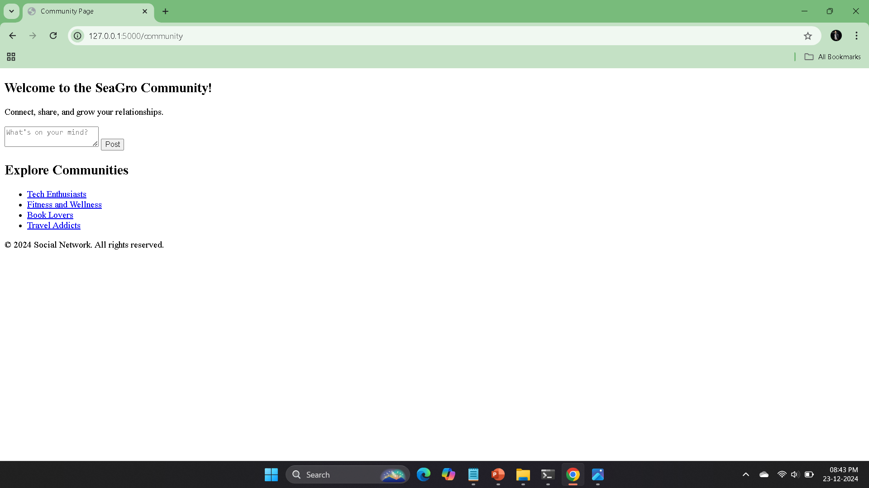
Community Page
. A platform for users to create posts and engage with others.
. Includes links to join various interest-based communities.

Slide 5
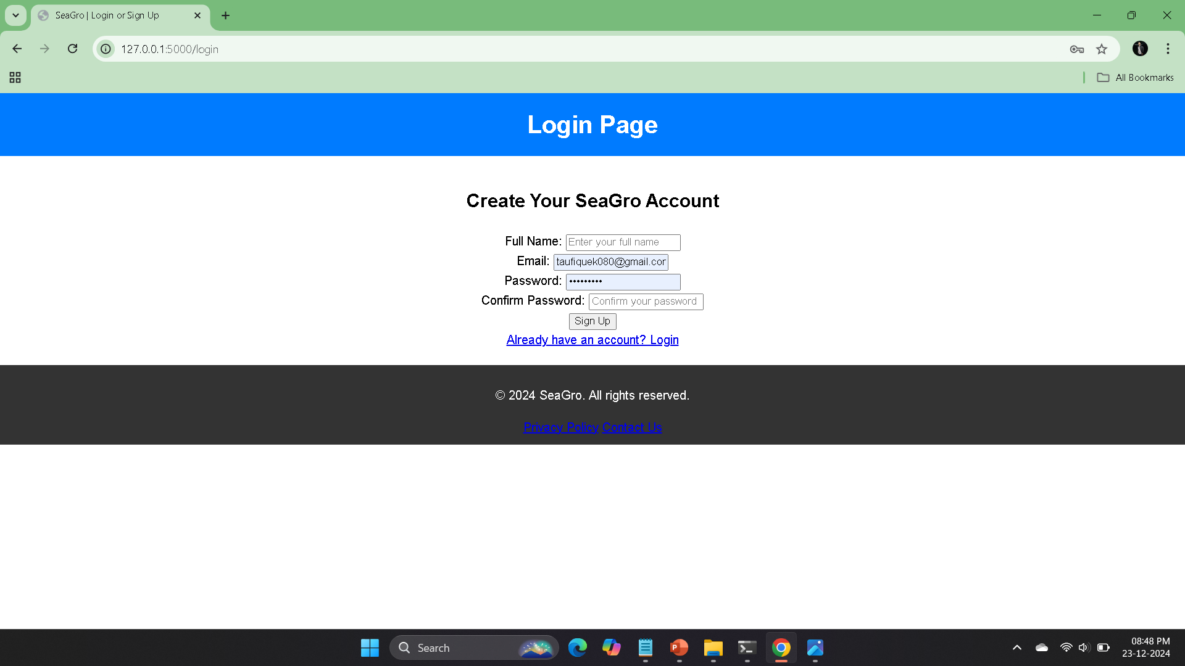
Login and Signup Page
. Toggleable forms for user login and registration.
. JavaScript-powered transitions for seamless form toggling.

Slide 6
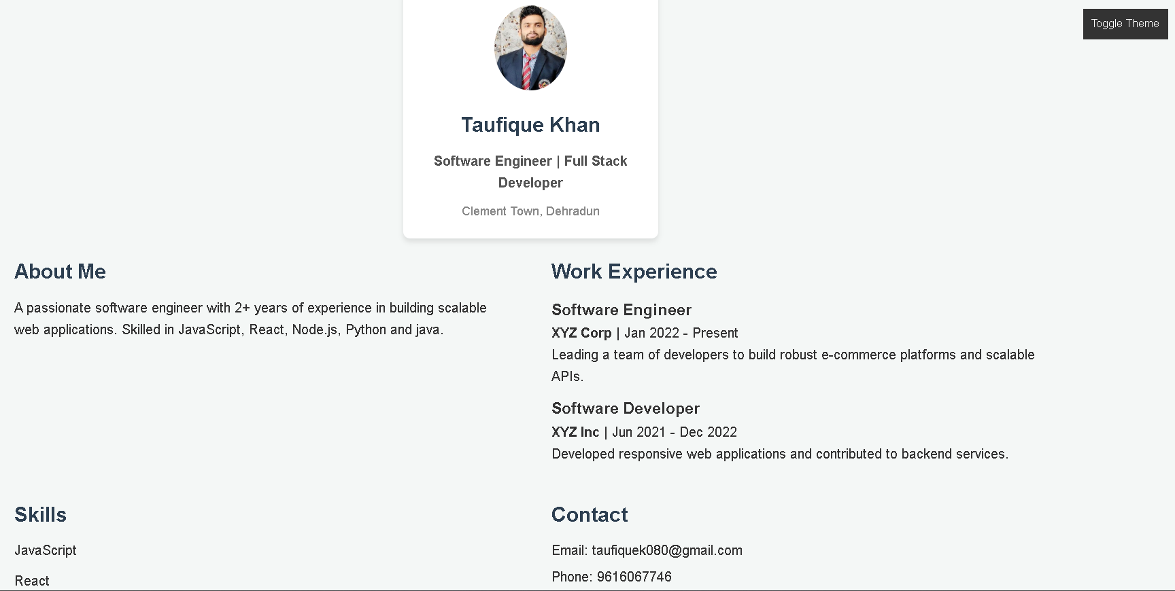
Profile Page
. Displays user information, skills, and work experience.
. Contact section for reaching out to the user.

